Slide 1
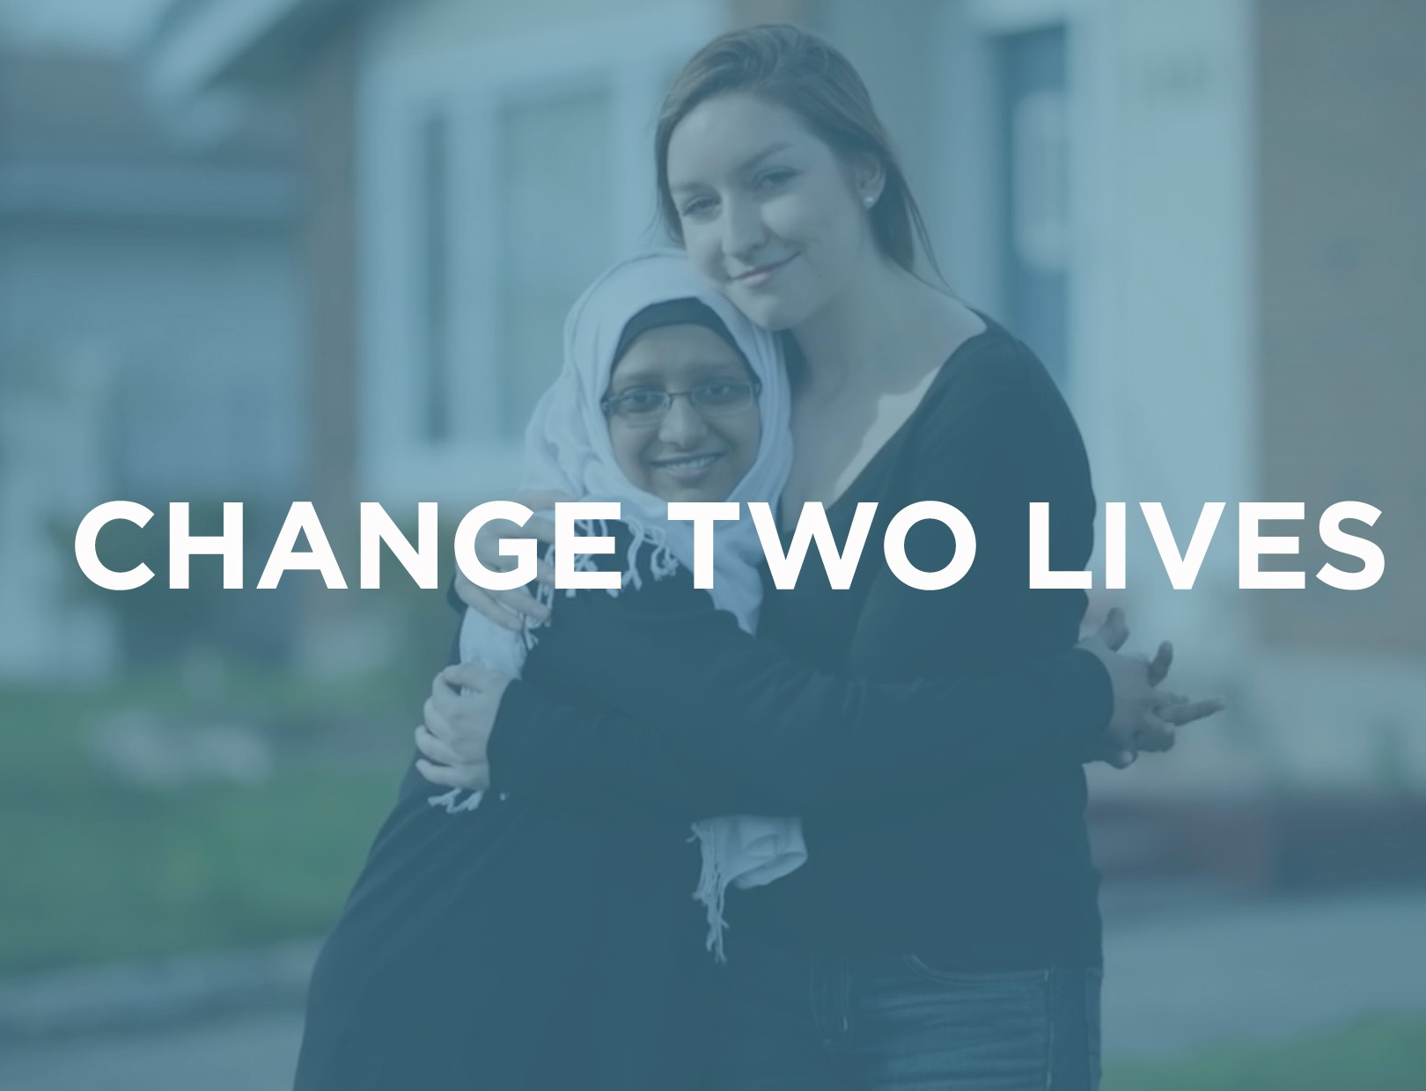

Able2 matching program

Slide 2
Welcome!
Thank you for your interest in our Matching Program at ABLE2.The following slides will give you an overview of our program. The information here will help you to decide whether you want to start your application with us.

Slide 3
Purpose
Give you an overview of the Matching Program
  Who, What, When, Where, Why, How
Review the basic requirements to be a Volunteer Ally
Review basic expectations of the Volunteer Ally
Tell you about next steps to become a Volunteer Ally

Slide 4
What if this isn’t a good fit?
There is no commitment at this stage – The information we provide here is just to help you decide if you want to start the application process or not.
You may have more questions and that’s okay. We recommend to people that if you are interested but have more questions; you should start the application process.
If you do not feel it is a good fit after you review the information, you can simply close the browser. No one will follow up with you.
You can always come back later – If you decide you want to do this, but can’t quite do it now, come back when you can.

Slide 5
matching program
The Matching Program at ABLE2 connects people in the community
Our volunteers are matched on a one-to-one basis with a person who has a disability
Our volunteers help to create an atmosphere of non-judgmental support, respect, and fun

Slide 6
Who is in the program
ABLE2 is unique because our service users are:
  Of any age – our range is from two to 80+
  Of any disability – physical, developmental, and/or mental health
  Located throughout the city of Ottawa
Our service users are known as Friends
Our volunteers are known as Allies

Slide 7
What do we do together
Anything you both feel comfortable doing!
Many of our matches:
  Go for walks or meet for coffee to talk
  Go to community events like Ribfest or Tulip Festival or participate in activities like Race Weekend
  Work together to achieve goals
You and your Friend decide together
You and your Friend do not have to spend any money to have a meaningful match
  We recommend that you both look for low-cost or free activities
  Allies are not required to spend money on their Friend. It should be a 50/50 split.

Slide 8
When do we meet
We ask matches to meet 3-4 times a month – about once per week
  Especially at the beginning to help develop rapport
You can meet when they have free time – there is flexibility
  You and your Friend can meet on a set day/time or change weekly
You can go away for the weekend or go on vacation
  We understand that you have your life to live as well
If you get really busy you don’t necessarily have to stop the match
  You can adjust how often you meet for a period of time

Slide 9
Where do we meet
You meet with your Friend in the community
Our matches meet
  In coffee shops, malls, or theaters
  At parks, in neighbourhoods
  You could even meet at each others’ homes if you feel comfortable

Slide 10
How are allies matched
We consider:
  Location – We won’t ask you to travel farther than you want
  Interests – We will match you with someone who has similar interests to you
  Personality – We look for Friends who match who you are
  Schedule – We consider when you will be available
We want you to have a match that fits you
  We want you to succeed

Slide 11
Why is the matching program important
People need meaningful relationships
  People with disabilities may lack trustworthy/reliable people in their lives
People who have disabilities are more socially isolated than the average person
Our Allies are important because you can develop a meaningful relationship by:
  Being a social connection – go out and have fun
  Being a practical support – find information, help with groceries
  Being an emotional support – be a nonjudgmental listener

Slide 12
What are the Basic requirements
You must be at least 18 years old, or will be turning 18 within the next two months
You are prepared to give at least 12 months to be a Volunteer Ally
  Please consider your status in Canada as it may effect your ability to make this commitment. Ex. Visitor visa, student visa, refugee claimant.
  Your 12 month commitment starts when you are matched, not when you start the application.
You have time during the week
  Please consider your responsibilities
  Are you planning to start a new business? Will you be starting a family? Do you have a loved one that you need to support?

Slide 13
What if I have a disability
ABLE2 have Allies who have disabilities
The only thing we need is for Allies to have a degree of independence
  Example – We have Allies who have depression or anxiety, while they may have some difficulty at times, it doesn’t stop them from meeting their match on a consistent basis
  Example – We had a successful Ally who was visually impaired but they were able to navigate the city and resources independently
Your Friend will not be expected to provide you with on-going support to make the match succeed

Slide 14
What can you expect from ABLE2
Once you are matched, you and your Friend work together
  You are expected to manage your match together
However, this does not mean you are completely alone
You have access to a social worker who can help you when you (or the Friend) need it
Social workers have helped matches with
  Finding resources
  Resolve arguments
  Provide support

Slide 15
Timelines
We know our process is thorough and takes a little longer than some other agencies – our overall goal is to create the best opportunities for you to succeed by:
  Finding a match that fits you
  Preparing you for what it means to be an Ally
If everything goes smoothly, you could be match in 1.5 months
How quickly you get through this process depends on you as well – the sooner you complete and book your appointments, the sooner you will complete the process

Slide 16
I am interested What do I do next
Complete an application form
  It will be available at the end of this slide presentation
Provide us with three references
  Your reference has to have known you for at least two years – there are no exceptions
  Your reference cannot be a family member or a romantic partner
  Your reference has to know you on a personal level
  Your reference does not have to live in Ottawa or Canada
  Your reference has to be able to communicate in English or French

Slide 17
I am interested What do I do next
Book an Onboarding Session
  This is a required workshop that is designed to give more detailed information about the matching program,
  Help you to feel more prepared to be a volunteer Ally
  ABLE2 will contact you to book your session.
Book a Learning Conversation
  This is required after you complete the Onboarding Session
  This is your assessment, but more importantly, this is the time we get to know you to find you a match who will fit you
You can download all the paperwork at the end of this slide presentation including a checklist.

Slide 18
I am interested What do I do next
Complete a Vulnerable Sector Check (VSC) application
  For ABLE2, your VSC must not be older than two months from the date of completion by Ottawa Police Service and submission
  You will need to renew your VSC every three years
Online: https://www.ottawapolice.ca/en/about-us/level-3---vulnerable-sector-check.aspx
  This is the quickest and easiest way to apply for a VSC
In Person: 2670 Queensview Dr. Ottawa
  Go in as early as possible to avoid long line ups
Please read the requirements for a VSC by Ottawa Police Service: https://www.ottawapolice.ca/en/about-us/FAQs.aspx

Slide 19
Frequently Asked Questions (FAQs)
I have a lot of experience working with people who have disabilities, do I have to attend an Onboarding Session?
  Yes. Onboarding is where we provide more detailed information about your role and our expectations about being an Ally.
I have no experience working with people who have disabilities. Is that going to be a problem?
  No. ABLE2 and your Friend do not expect you to be an expert of any kind. Most of our Friends want someone who can treat them with respect, dignity, and kindness.
I am applying for graduate school and may not be here in a year. Could I have a match that runs for less than a year?
  No. Our Friends expect at least a year from their Ally. Most of our Friends have shared that they do not feel good about seeing someone for under one year

Slide 20
FAQs
My references live in a different country. Is that okay?
  Yes, we can call long-distance within North America or we can email a reference form to people outside of North America.
My reference is my boss, but they know me really well personally, is that a problem?
  Not at all! Your business skills are important, but we really want to know if you have the interpersonal skills/emotional intelligence needed to be a successful Ally. So if your boss knows you personally that is good for us.

Slide 21
FAQs
I made some mistakes and now have a criminal record. Should I bother applying?
  Yes. We all make mistakes and ABLE2 wants to have an open-minded conversation about what happened and whether it will be a problem now.
  The only time a vulnerable sector check will automatically prevent you from being an Ally is if there is a charge/conviction related to vulnerable people (minors, people with disabilities, seniors).
Do I need to be able to speak English or French perfectly?
  No. However, you need to be able to communicate in English or French well enough to have conversations with people.

Slide 22
FAQs
The match just isn’t working. Do I have to do this for 12 months?
  If your match isn’t working, you and the social worker have discussed your concerns, engaged in problem solving, and it still doesn’t work then the match will end. This may not prevent you from being matched to someone else.
I’m really enjoying my match. Can I keep going with this match once my 12 months are finished?
  That’s wonderful! If you and your Friend are happy with each other, the match may continue indefinitely. We have matches that have been together 20+ years.

Slide 23
Thank you

